Slide 1
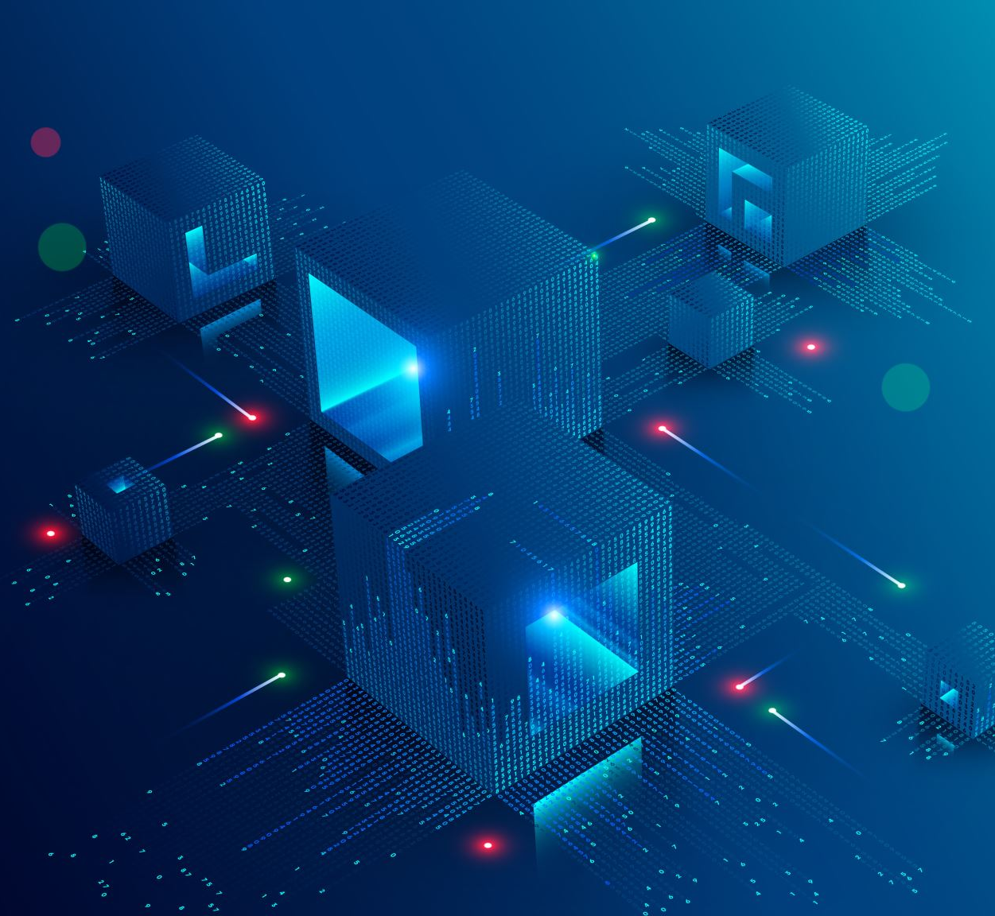
Session 7
Main menu
Loading scenes
Music

